Slide 1



Arabic Cyberbullying Detection using Arabic Sentiment Analysis using WEKA Tool
Athar Berri

Slide 2

Arabic Cyberbullying Detection using Arabic Sentiment Analysis using WEKA Tool
Abstract:
Dataset Labeling:
The dataset contents are labelled by both means, automatic and manual, in order to maintain the efficiency of the detection of CyberBullying tweets.
Data Collection and Pre-processing:
Cyberbullying is using aggressive and offensive words through internet technology. The dataset is labeled based on tweet nature. Pre-processing techniques include normalization, tokenization, light stemming, Arabic stemming, and TF-IDF term weighting.
Experiments and Results:
Experiment 1
Experiment 2
Experiment 3
Using WEKA with Light Stemmer
Using WEKA with ArabicStemmerKhoja
Using Python

Slide 3
Defintion

Slide 4
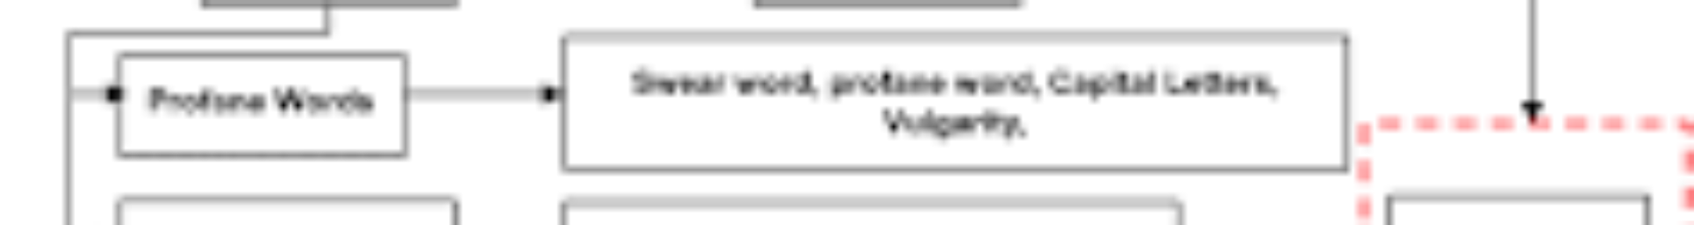
Introduction to Arabic Cyberbullying Detection
1
The Internet Revolution
The Internet has revolutionized the lifestyle; a distance of thousands of kilometers is now just a number; a person can remain in contact with another person with the help of the Internet.
2
Social Media Boom
Social media platforms like Instagram, Twitter, and Facebook have given a great boom to the Internet; people can share their opinions on various topics.
3
Risks Involved
There are risks involved in sharing opinions on social media, including the risk of CyberBullying.
4
Fame or Fired
Tweets can have a significant impact, as they can either make you famous or get you fired.
5
The Problem of CyberBullying
CyberBullying refers to bullying a person using the Internet and technology. It is a modern problem that needs to be addressed.
6
Solution with Machine Learning
Using Machine Learning techniques, such as "simulated annealing," can be effective in detecting CyberBullying tweets by analyzing and classifying text into sentiment classes.
7
Challenges with Non-English Languages
Detecting CyberBullying in languages other than English, such as Arabic, poses additional challenges.
8
Sentiment Analysis Experiment
Several experiments are conducted to detect CyberBullying in Arabic tweets using Sentiment Analysis (SA) algorithms and Machine Learning techniques.
9
Complexity of Arabic Language
The complexity of Arabic morphology and diverse dialects pose challenges in applying the SA algorithm approach.
10
Utilizing Support Vector Machine
Support Vector Machine (SVM) is used as a standard classifier for the SA algorithm approach in detecting CyberBullying in Arabic tweets.
11
Data Mining and Experimentation
The WEKA tool and Python are utilized for data mining and building models to experiment with the detection of CyberBullying in Arabic tweets.
12
Data Acquisition
The dataset for the experiment is obtained from Twitter using the Application Programming Interface (API) and ArabiTools.

Slide 5
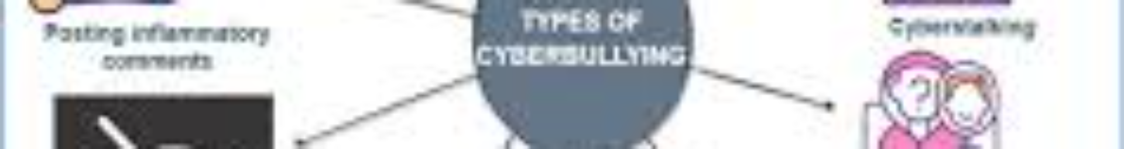
The Internet Revolution
Social Media Boom
Risks Involved
Fame or Fired
The Problem of CyberBullying
Solution with Machine Learning
Challenges with Non-English Languages
Sentiment Analysis Experiment
Complexity of Arabic Language
Utilizing Support Vector Machine
Data Mining and Experimentation
Data Acquisition

Slide 6
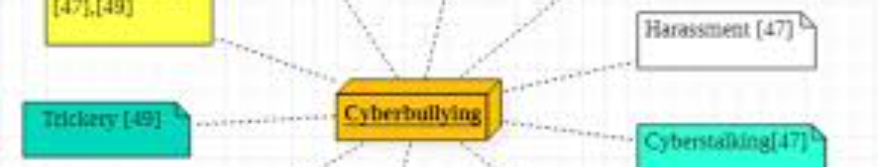
Research Scope
3.This approach is mainly focused on classification accuracy instead of classification speed because the detection of Cyberbullying tweets is an essential factor.
This research is only focused on the “Arabic Language” tweets. We focused only on Arabic language tweets.
Our dataset is obtained by random collection and by using the query-oriented method.

Slide 7
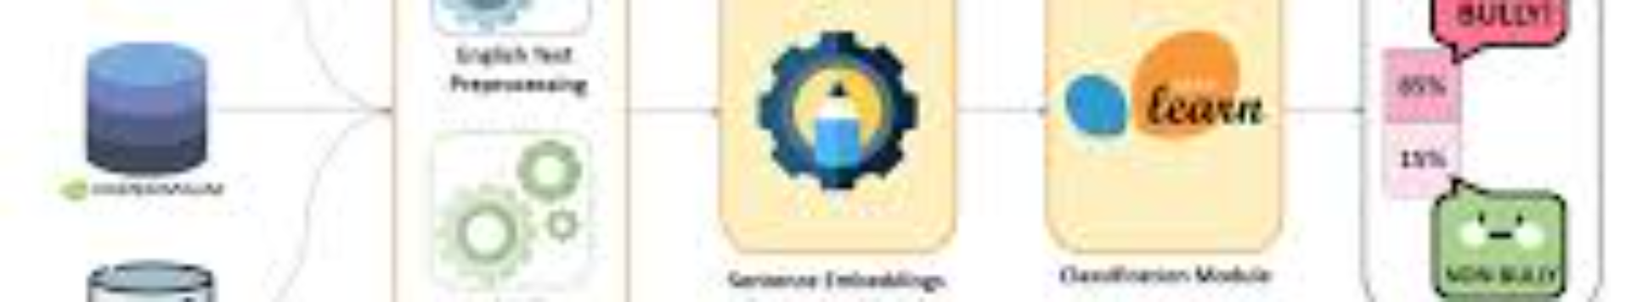
Research Questions •
Q1: Challenges and Solutions for Arabic Language Processing
Q2: Impact of Preprocessing on Model Classification Accuracy
Q3: Comparison of Data Mining Tools for Better Results
Q4: Efficiency of Data Mining Tools for Model Classification

Slide 8

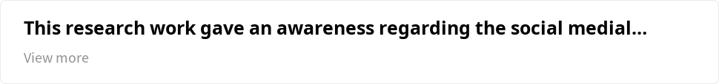
Research Significance
1
Key Points:
2
Cyberbullying Detection:
This research work raised awareness regarding the issue and tried to detect cyberbullying on Twitter.
3
Importance for Government and Organizations:
4
Usefulness of Designed Models:
Our designed models to detect cyberbullying from tweets can be useful for systems working on cyberbullying.
Detecting cyberbullying is essential for the government and organizations.
Our models can also be useful for organizations related to adult affairs and children, like education and sports organizations.

Slide 9
1
This research work gave an awareness regarding the social medial CyberBullying and tried to detect the CyberBullying on Twitter.
Our designed models to detect from tweets can be useful for the systems working for CyberBullying.
2
For the government and organization, it is quite essential to detect the CyberBullying.
Our models can also be useful for the organization related to adult affairs and children like education, sports organization.

Slide 10
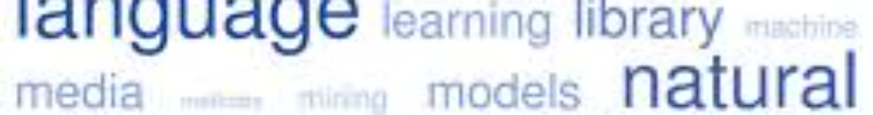
1
Background Section
All the essential theories related to the topic are discussed.
Literature Review
2
Previously done research is discussed.
3
Methodology
All the proposed methods that are used for this research are explained.
Result Section
4
All the proposed experiments are applied using the WEKA and Python tools with the SVM classifier, and the results are shown in tables and graphs.
5
Discussion Section
All the experiments performed by WEKA and Python in this research and their results are discussed.
Conclusion Section
6
Conclusive summary of the whole research work.

Slide 11

Background
Key Concepts

Slide 12
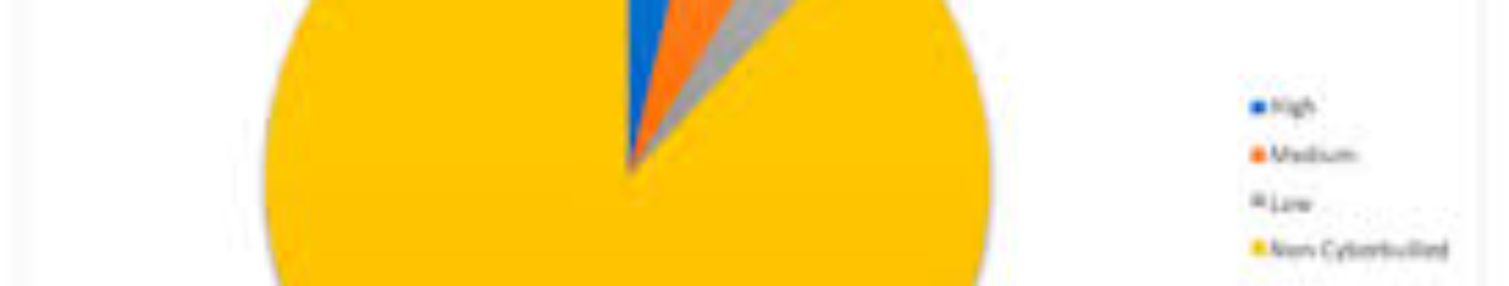

Background Cont.

Slide 13
1
Arabic Language
The Arabic language is widely spoken and holds cultural and religious significance. It has different forms including Classic Arabic, Modern Standard Arabic (MSA), and Colloquial Arabic.
Arabic Twitter Users
2
Twitter has around 5 million Arabic users, with the Kingdom of Saudi Arabia having 2.4 million active users.
3
Challenges of Arabic
Arabic poses challenges due to its complex morphology, diacritics, and dialects.
Sentiment Analysis Research
4
There is a research gap in Sentiment Analysis for Arabic.
5
Twitter and Cyberbullying
Twitter is a platform for sharing opinions and experiences, but it also faces issues like CyberBullying.
Data Extraction
6
Data extraction from Twitter can be done using the Twitter API.

Slide 14
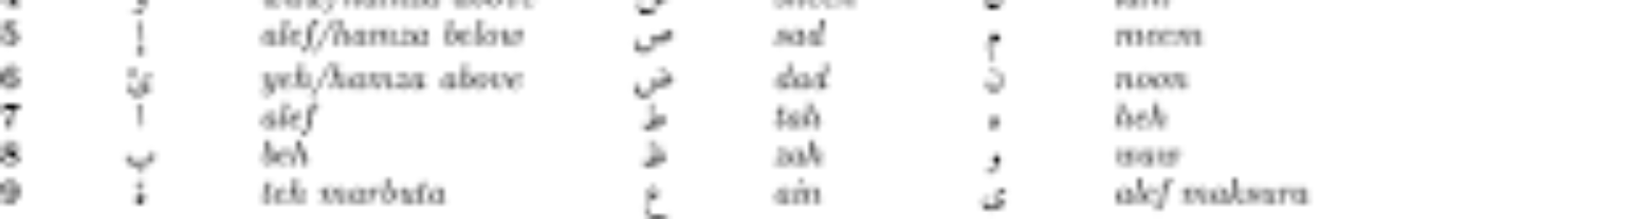
L ITERATURE REVIEW
1
Research Gap for the Application of SA in Arabic Language
We have very rare research
In the early stage of SA, there was work on the basis of text mining, but it revolved rapidly.
Previously, it could only classify negative and positive sentiments.
2
Development of Machine Learning
The ML is used with several algorithms, including SVM, K-nearest neighbor (KNN) , Naïve Bayes (NB), and Decision Tree (DT).
“Arabic Sentiment Analysis” (ASA) is conducted by using the MSA and other Arabic dialects like Egyptian.
The concern about the TC is based on the steps.
3
Steps
Data Collection (web pages)
Preprocessing (subprocesses)
Selection of Features
Data Classification
The Evaluation of Data

Slide 15


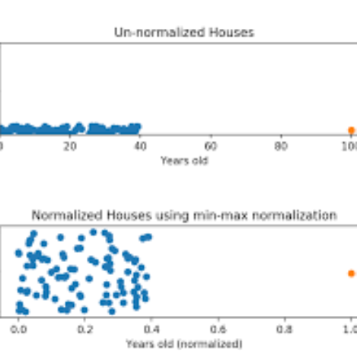
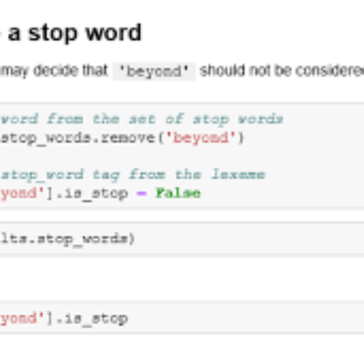
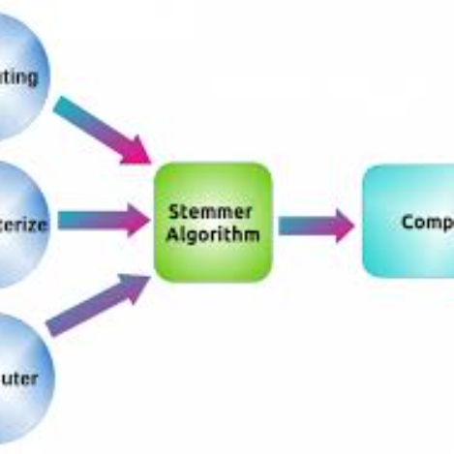
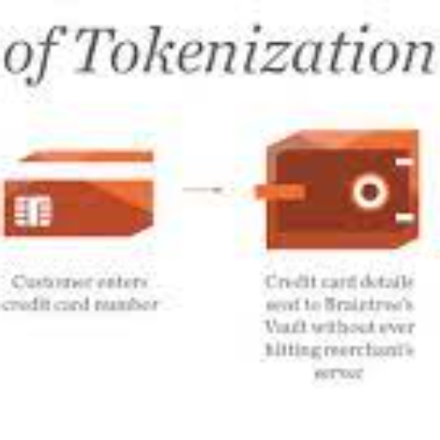
Data Pre-processing
Data Cleaning
Data Normalization
Removal of Stop Words
Stemmer
Tokenization

Slide 16

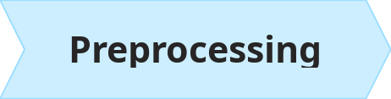
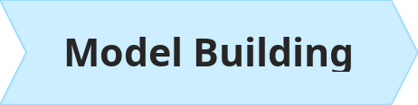
Osaimi
He studied the sentimental analysis for the Arabic language and introduced an automatic method that can predict the sentiments of Arabic tweets along with emotion icons:
Several Sub-processes:
KNN (59.04% accuracy), NB(63.79%accuracy), and RapidMiner tools

Slide 17
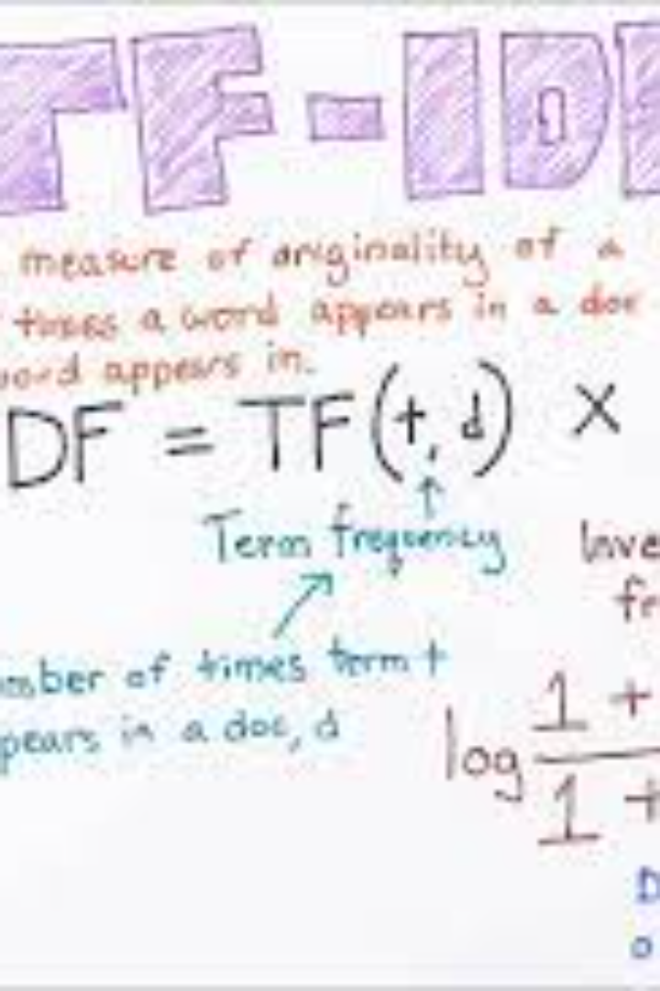
“Term Frequency-Inverse Document Frequency” (TF-IDF)
Nalini et al. com They compared their proposed method with the baseline methods of TF-IDF and semantic.

Slide 18
Tf-IDF Cont.
Term
Description
TF
Measures how frequently a term appears in a document
IDF
Measures how important a term is in a corpus of documents
TF-IDF
Assigns a weight to each term in a document based on its TF and IDF values
The weight of a term is proportional to its TF and IDF values. Terms that appear frequently in a document but rarely in the corpus are given a high weight, while terms that appear frequently in both the document and the corpus are given a low weight.

Slide 19
Bouchlaghem et al.
1
Developed an approach to translate Arabic tweets used for terrorism.
Solved the problem of duplicate tweets using similarity measurement.
2
Used N-gram features, linguistic and syntactic features, and tweets specific features.
3
Results showed SVM as the best performing classifier compared to Random Forest, NB, KNN, and DT.

Slide 20
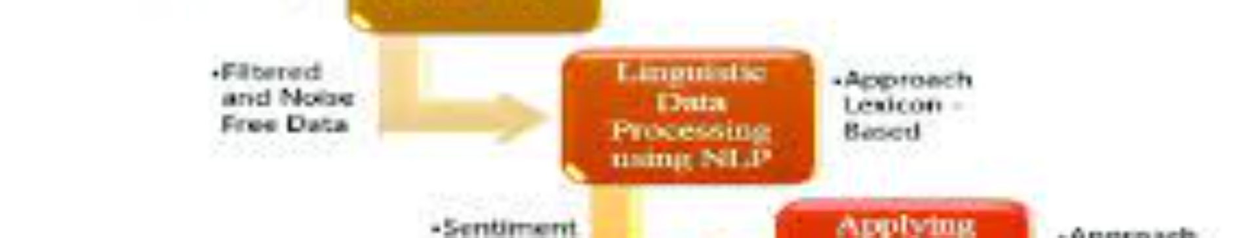
Magdy
About the Approach
Solving the Problem of Duplicate Tweets
Research Results

Slide 21
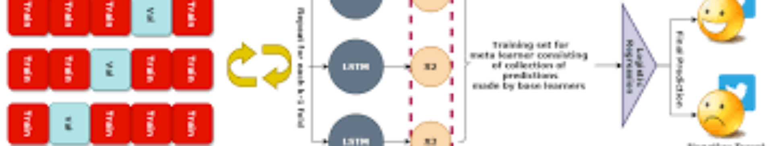

Nandakumar et al.
Have applied the “binary classification” for the purpose of Cyberbullying detection in the tweets by using the NB algorithm.
Binary Classification

Slide 22
Abdelaal et al.
1
Classification of Arabic Tweets
2
Improving Classification Accuracy
Abdelaal et al. categorized Arabic tweets into predefined topics.
They focused on enhancing accuracy through ensemble classification methods.
3
Three Sub-Processes
4
Ensemble Methods Outperform
Their proposed process included collection, preprocessing, and classification of tweets.
Results showed that ensemble methods performed better than individual classifiers.

Slide 23
Results
The accuracy of SVM was increased by 2.2%.
The accuracy of DT was improved by 3.2%.
The accuracy of NB was improved by 1.6%.

Slide 24
Other Studies in the Field
Study
Approach
Key Findings
AlHarbi et al.
Lexicon approaches and sentiment analysis
- Java programming language used - Dataset collected from YouTube, Microsoft-Flow, and Twitter API - PMI approach identified cyberbullying effectively
L. Cheng et al. [36]
PI-Bully framework
- Incorporates interdisciplinary findings - Considers individual differences in predicting cyberbullying behavior
A. Bellmorea et al. [37]
Frequency vector and text classifier
- Frequency vector constructed for each tweet - Text classifier used with a Twitter corpus dictionary - Answered main questions about online bullying
H. L. Haoti Zhong et al. [38]
Image sharing networks and captions
- Focused on cyberbullying detection in image sharing networks, particularly on Instagram - Captions identified as significant predictors of cyber harassment

Slide 25
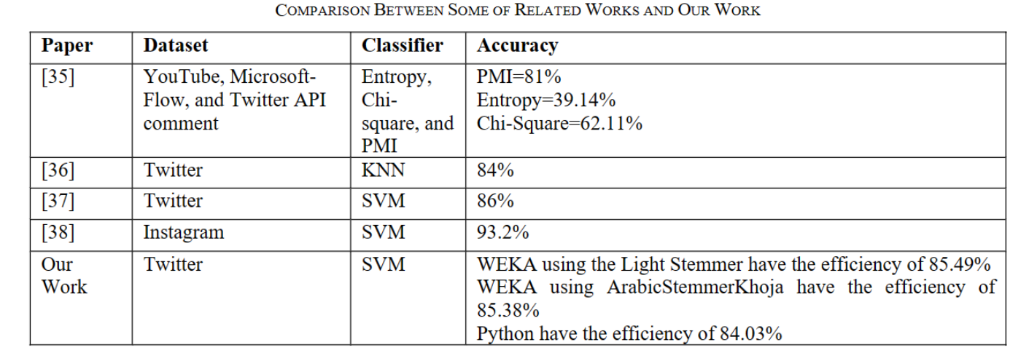

Slide 26
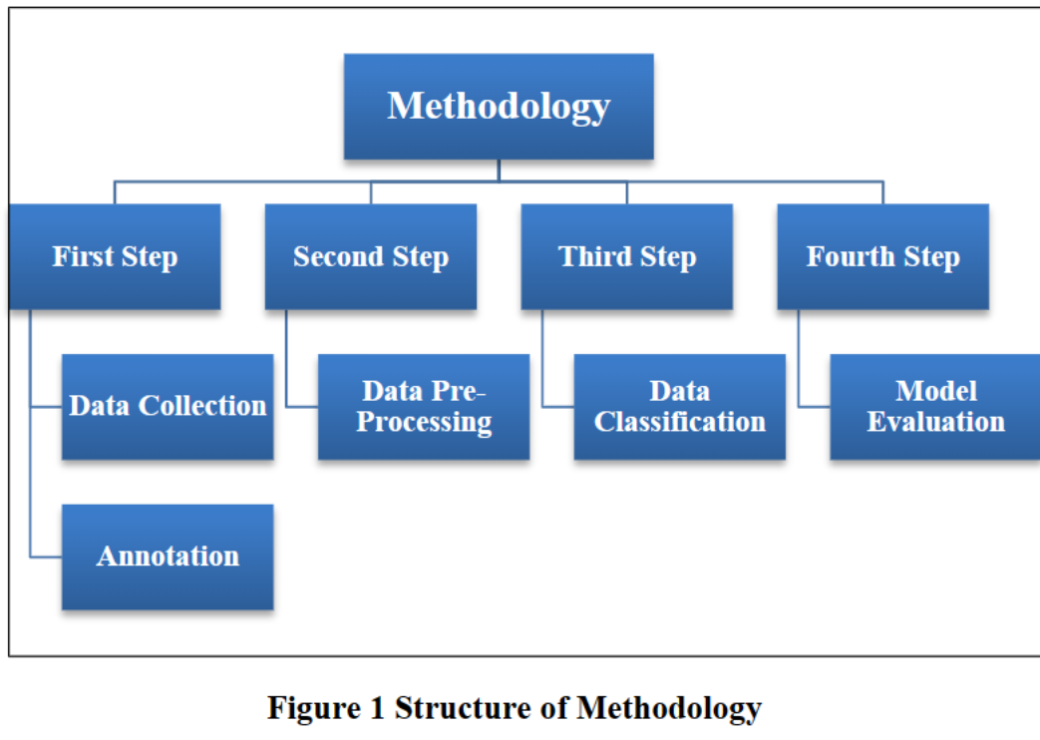
Methodology

Slide 27

Data Collection and Annotation
The data was collected by using the ArabiTools and Twitter API via two different methods:
1
Random Selection
Words searched randomly
Query-Oriented
2
Words searched using specific keywords related to Arabic CyberBullying
1
The dataset
2
Total tweets
3
CyberBullying tweets
The dataset was obtained from the tweets written in MSA.
There were a total of 17,748 Arabic tweets collected.
Out of the total tweets, 14,178 were classified as CyberBullying tweets.
4
Non-CyberBullying tweets
5
Dataset name
6
Data format
Our dataset is called AraBully-Tweets.
The dataset was stored in the "Comma Separated Value" (CSV) format.
3,570 tweets were classified as Non-CyberBullying tweets.
7
Conversion
It was then converted to the "Attribute-Relation File Format" (ARFF) using WEKA.

Slide 28
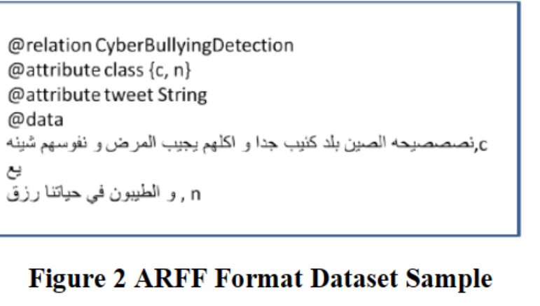

Slide 29
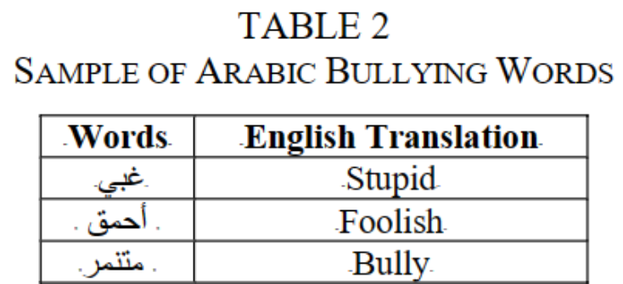
Data Collection and Annotation Cont.

Slide 30
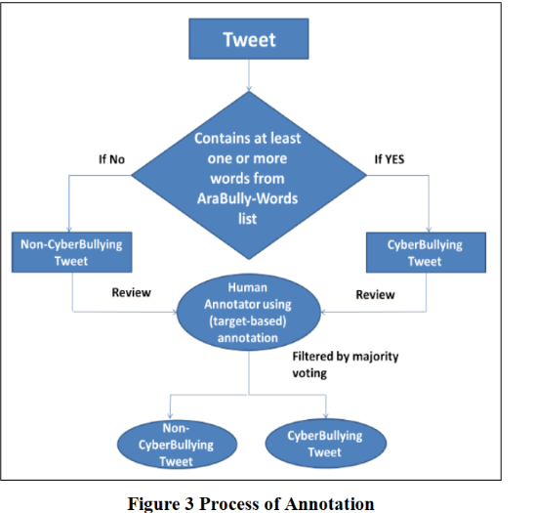
The Process of Annotation
Data Collection
Annotation Process
The dataset was collected and prepared for annotation.
The dataset was annotated using Python code.
Data Classification
Model Evaluation
The tweets were classified as CyberBullying or Non-CyberBullying.
The performance of the model was evaluated and checked for efficiency.

Slide 31
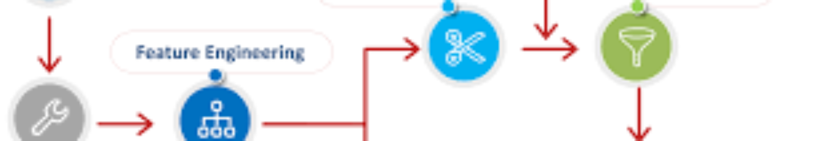
2. Data Preprocessing
1
Data Cleaning
The dataset is cleaned by removing noise such as non-Arabic letters, user mentions, single Arabic characters, numbers, special characters, duplicate tweets, re-tweets, and pictures of the tweets.
2
Data Normalization
All different forms of Arabic words are converted into a consistent shape, including converting ي to ی and آ to ا. Punctuation, diacritics, and the lengthening of Arabic writing are also removed.

Slide 32
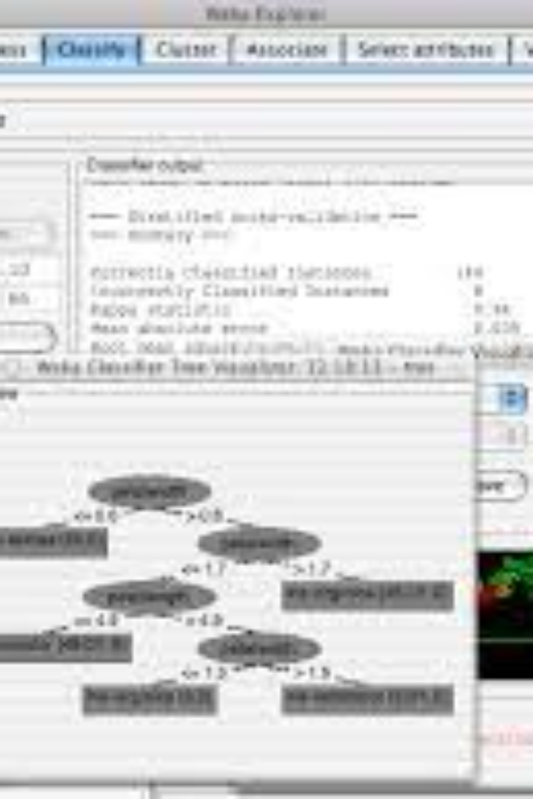
WEKA
Here is a summary of the WEKA tool based on the current web page:
WEKA: A software for data mining tasks, such as classification, clustering, association rules, regression, and visualization.
Features: WEKA provides a graphical user interface for easy access to its algorithms and supports various file formats and databases.
Applications: WEKA can be used for various purposes, such as exploratory data analysis, feature selection, model building, model evaluation, and model deployment. WEKA can also be extended with new algorithms and functions by using its plugin mechanism.
Availability: WEKA is an open source software, licensed under the GNU General Public License. WEKA is written in Java and runs on any platform that supports Java. WEKA can be downloaded from its official website or its GitHub repository.

Slide 33
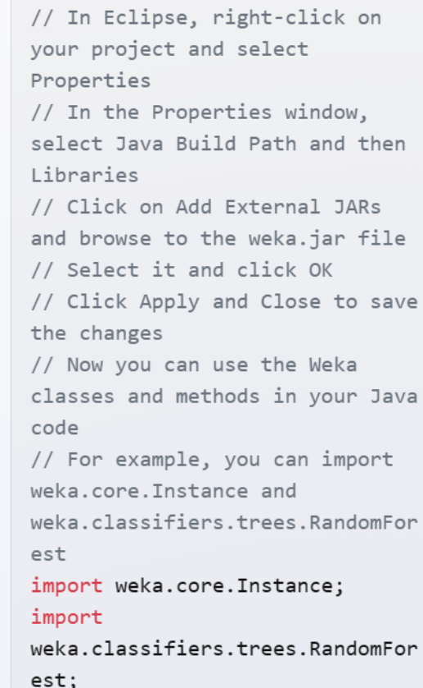
How to Import WEKA

Slide 34

Explanation of WEKA (Waikato Environment for Knowledge Analysis)
Tool for Sentiment Analysis
Data Preparation
Loading Data
Preprocessing
Format your data in CSV or ARFF format.
The dataset, obtained from Twitter using the API and ArabiTools, is loaded into WEKA. The dataset consists of labeled tweets, where cyberbullying tweets are marked as such, and non-cyberbullying tweets are labeled accordingly.
This typically involves steps such as tokenization, normalization, removing stop words, and converting text into numerical features.
Feature Extraction
Model Training
Evaluation
WEKA provides feature selection algorithms to choose the most informative features from the dataset.
The researchers trained the SVM algorithm on the preprocessed dataset to learn the patterns and relationships between the features and the corresponding labels.
The trained model is evaluated using evaluation metrics such as accuracy, precision, recall, and F1 score
Model Deployment
Use the trained model to classify new data.

Slide 35
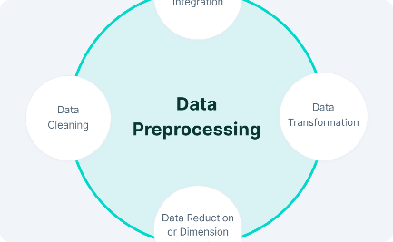
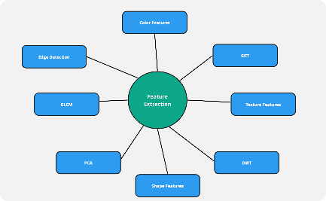
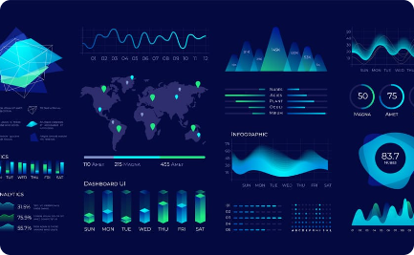
Data Preprocessing Steps with Images
Data Cleaning
Feature Extraction
Data Visualization

Slide 36
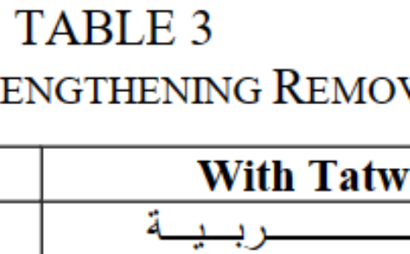
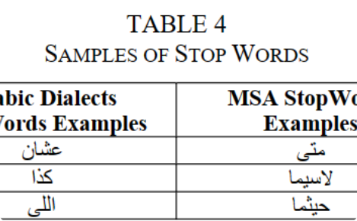
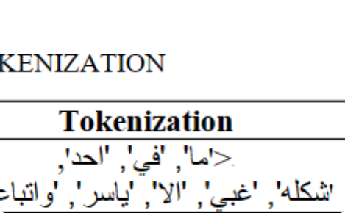
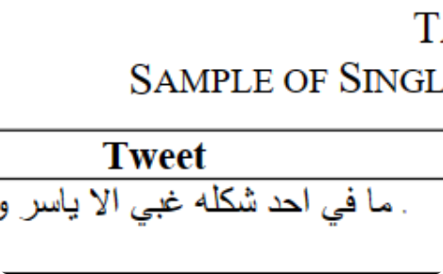
Furthermore, punctuation, diacritics, and the lengthening of the Arabic writing (Tatweel) are removed.
There are some stop words (prepostions,pronouns, and conjunctions)are removed with the MSA and Arabic Dialects.
Stemming:Removal of affixes to keep the word in root or stem forms. Two major approaches: 1. Root-Based Stemmer (Khoja Stemmer) implemented on WEKA 2. Light Stemming used in AraNLP
Tokenization:Conversion of unstructured text to discrete token sequence using white spaces and punctuation marks. Single word tokenization employed.
Single word tokenization: Input: "Hello, how are you?" Output: ["Hello", "how", "are", "you"]
Root-Based Stemmer: کﺎﺗﺐ, کﺘﺎب, ﻣکﺘﺒہ → کﺘﺐ Light Stemming: کﺎﺗﺐ, کﺘﺎب, ﻣکﺘﺒہ → کاﺗﺐ

Slide 37
Steps Including Arabic examples mentioned in the text:
Step
Description
Example
Stemming
Removal of affixes to keep the word in root or stem forms. Two major approaches: 1. Root-Based Stemmer (Khoja Stemmer) implemented on WEKA 2. Light Stemming used in AraNLP
Root-Based Stemmer: کﺎﺗﺐ, کﺘﺎب, ﻣکﺘﺒہ → کﺘﺐ Light Stemming: کﺎﺗﺐ, کﺘﺎب, ﻣکﺘﺒہ → کاﺗﺐ
Tokenization
Conversion of unstructured text to discrete token sequence using white spaces and punctuation marks. Single word tokenization employed.
Single word tokenization: Input: "Hello, how are you?" Output: ["Hello", "how", "are", "you"]

Slide 38
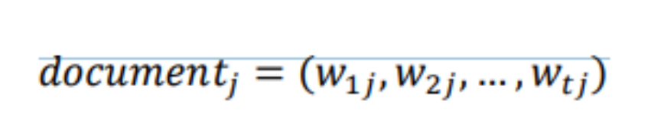
1
In the context of text vectorization
𝑑𝑗 is a t-dimensional vector that represents a document j.
Each element of the vector corresponds to a unique word (t) in the document.
The value of each element is the real-valued weight assigned to the corresponding term (t) in the document (j).
The weight assigned to each term is determined by the term frequency-inverse document frequency (TF-IDF) algorithm.
2
Term frequency-inverse document frequency (TF-IDF) algorithm
The TF-IDF algorithm assigns a weight to each term based on its frequency in the document and its frequency in the entire corpus of documents.
Terms that occur frequently in a document but rarely in the corpus are given a higher weight, while terms that occur frequently in both the document and the corpus are given a lower weight.
3
Summary
In summary, 𝑑𝑗 is a vector with t dimensions representing document j. Each dimension corresponds to a unique word in the document and is assigned a weight based on its frequency in both the document and the entire corpus of documents.

Slide 39
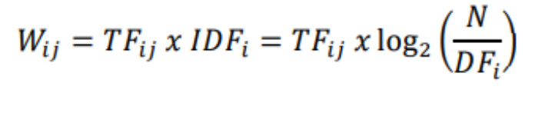
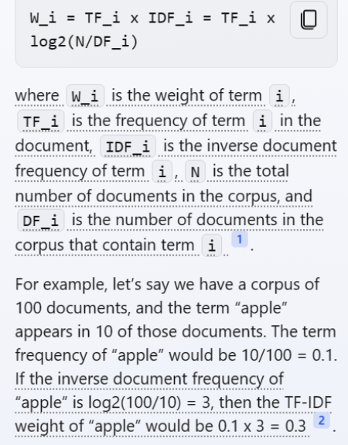
In text classification, it is important to choose an appropriate “term weighting scheme” to improve performance. Some of the most common term weighting schemes include the Boolean model, Term Frequency (TF), Inverse Document Frequency (IDF), and TF-IDF 1. In this research, the TF-IDF term weighting scheme is used. It can be calculated using the following formula:

Slide 40
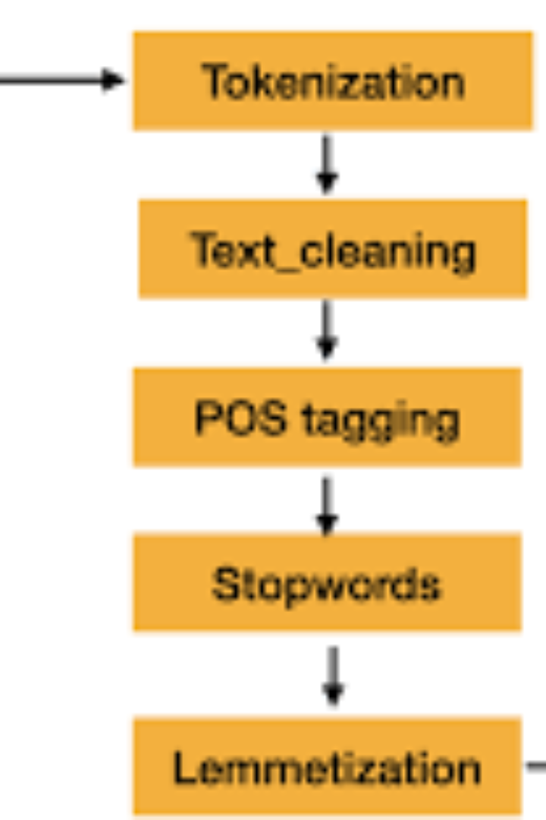
Data Classification
We used "supervised learning algorithms" (SVM)

Slide 41
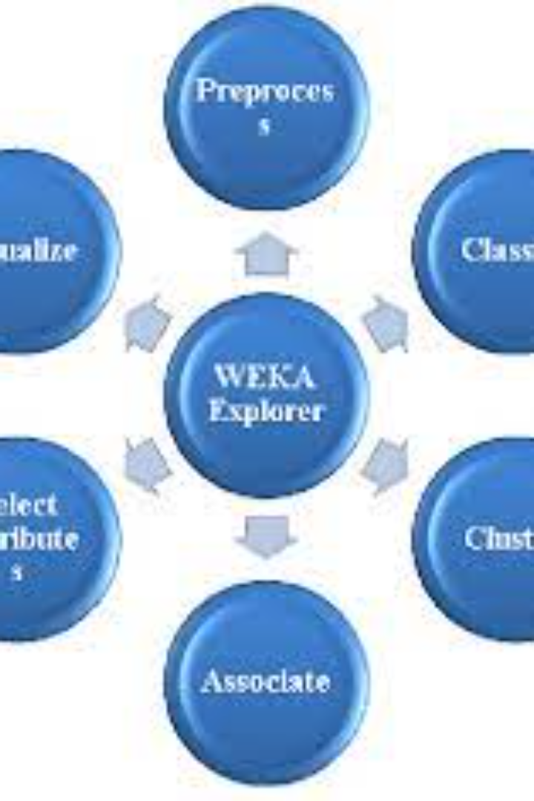
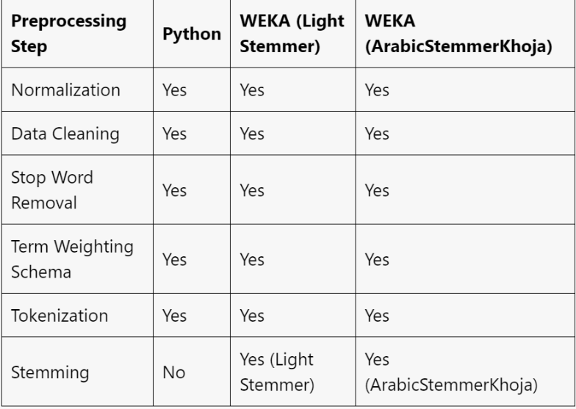
Preprocessing Using WEKA and Python

Slide 42
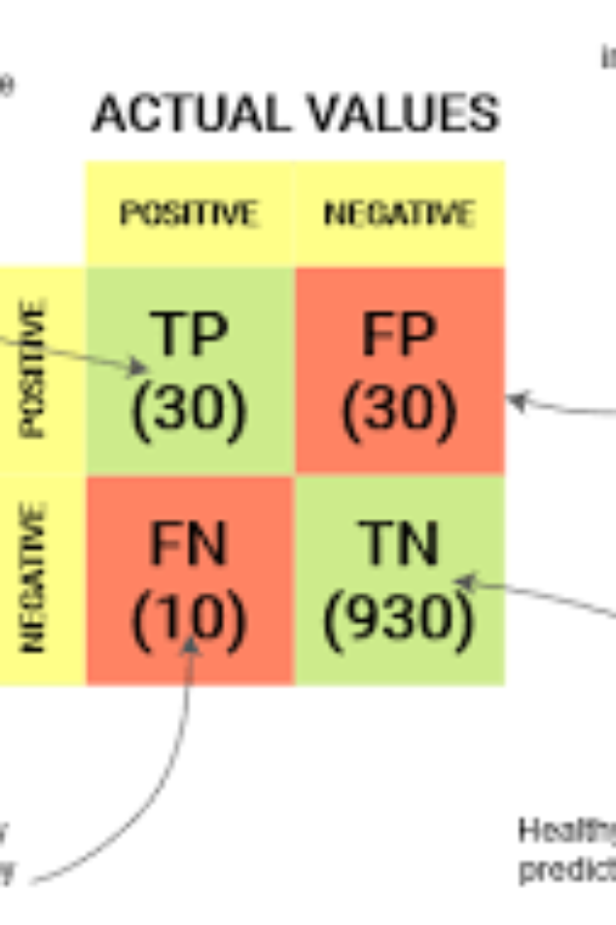
Model Evaluation:
Confusion Matrix
True Positives (TP): These are the cases where the model correctly predicted the positive class (e.g., correctly identifying a person with a disease).
True Negatives (TN): These are the cases where the model correctly predicted the negative class (e.g., correctly identifying a person without a disease).
False Positives (FP): These are the cases where the model predicted the positive class incorrectly (e.g., classifying a healthy person as having a disease, also known as a Type I error).
False Negatives (FN): These are the cases where the model predicted the negative class incorrectly (e.g., classifying a person with a disease as healthy, also known as a Type II error).

Slide 43
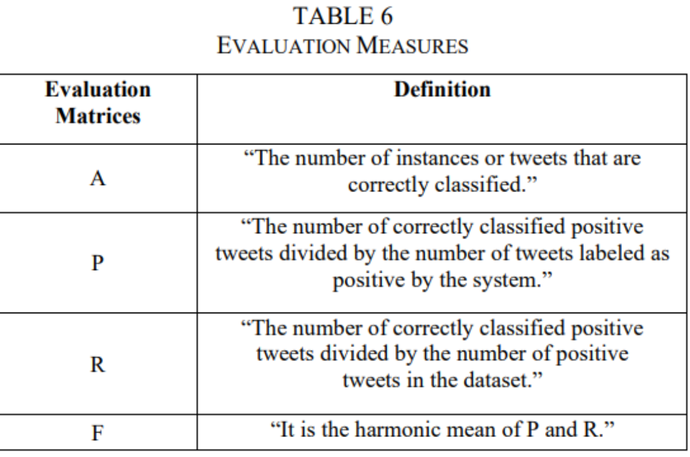
Confusion Matrix

Slide 44
Confusion Matrix
Accuracy (A): It measures the overall correctness of the model's predictions and is calculated as:
A = (TP + TN) / (TP + TN + FP + FN)
Precision (P): It quantifies the model's ability to correctly predict the positive class and is calculated as:
P = TP / (TP + FP)
Precision focuses on the proportion of true positive predictions out of all positive predictions made by the model.
Recall (R) or Sensitivity or True Positive Rate (TPR): It measures the model's ability to correctly identify the positive class instances and is calculated as:
R = TP / (TP + FN)
Recall focuses on the proportion of true positive predictions out of all actual positive instances.
F1-Score (F): It is the harmonic mean of precision and recall, providing a single measure that balances both measures. It is calculated as:
F = 2 * (P * R) / (P + R)
The F1-score combines precision and recall into a single metric and is useful when there is an uneven class distribution.

Slide 45
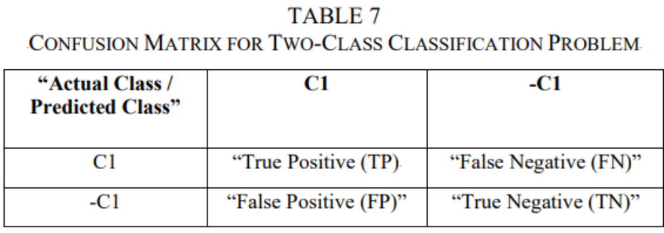
Confusion Matrix Cont.

Slide 46
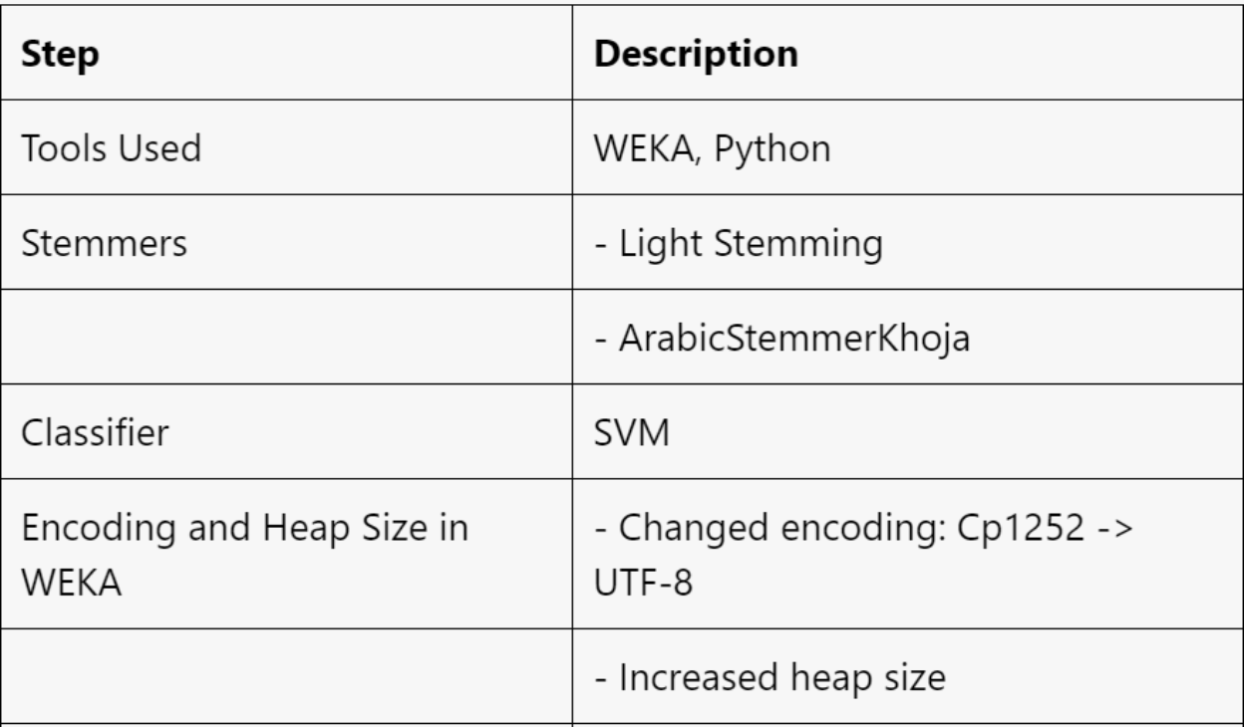
Steps and Results
.

Slide 47
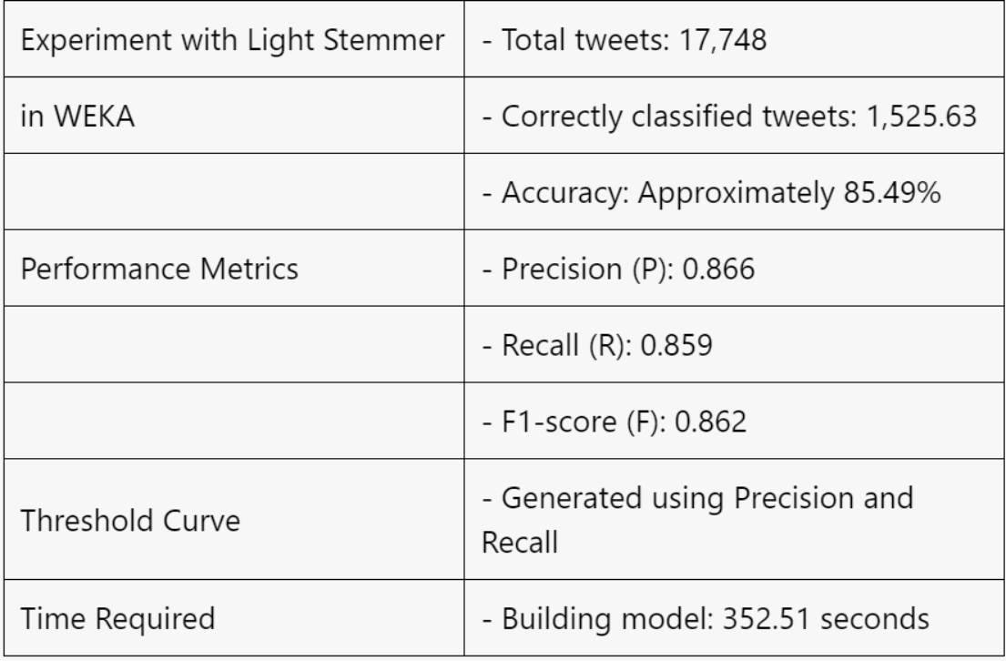
Results of Using WEKA with Light Stemmer

Slide 48
The evaluation measures derived from the confusion matrix provide valuable insights into the performance of a classification model. Here's what each measure tells you:
Accuracy (A): Accuracy represents the overall correctness of the model's predictions across all classes. It tells you the proportion of correctly classified instances (both positive and negative) out of the total number of instances. A higher accuracy indicates a better overall performance. However, accuracy can be misleading when the dataset is imbalanced, meaning one class has a significantly larger number of instances than the other.
Precision (P): Precision focuses on the positive class (or a specific class of interest) and tells you the proportion of correctly predicted positive instances out of all instances predicted as positive. It measures how precise the model is when it predicts the positive class. Higher precision indicates a lower rate of false positives, meaning fewer instances are incorrectly identified as positive.
Recall (R) or Sensitivity or True Positive Rate (TPR): Recall focuses on the positive class (or a specific class of interest) and tells you the proportion of correctly predicted positive instances out of all actual positive instances. It measures how well the model captures the positive instances in the dataset. Higher recall indicates a lower rate of false negatives, meaning fewer positive instances are missed or incorrectly labeled as negative.
F1-Score (F): The F1-score combines precision and recall into a single metric. It provides a balanced measure that considers both false positives and false negatives. The F1-score is useful when you want to find a balance between precision and recall. It is particularly valuable when the class distribution is imbalanced.

Slide 49
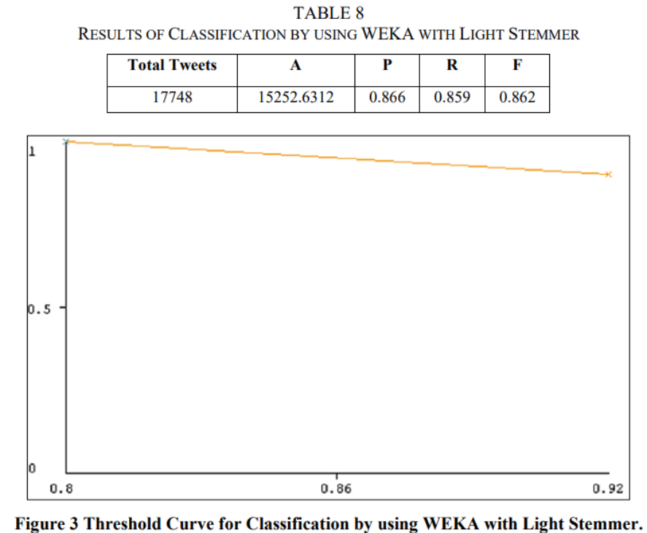
Results of Using WEKA with Light Stemmer

Slide 50
Results of Using WEKA with Arabic Stemmer Khoja
Step
Description
Tools Used
WEKA
Stemmer
ArabicStemmerKhoja
Classifier
SVM
Experiment with ArabicStemmerKhoja in WEKA
- Total tweets: 17,748
- Correctly classified tweets: 15,154
- Accuracy: Approximately 85.3843%
Performance Metrics
- Precision (P): 0.851
- Recall (R): 0.854
- F1-score (F): 0.852
Threshold Curve
- Graphical representation of Precision (P) and Recall (R)
Time Required
- Building model: 212.12 seconds

Slide 51
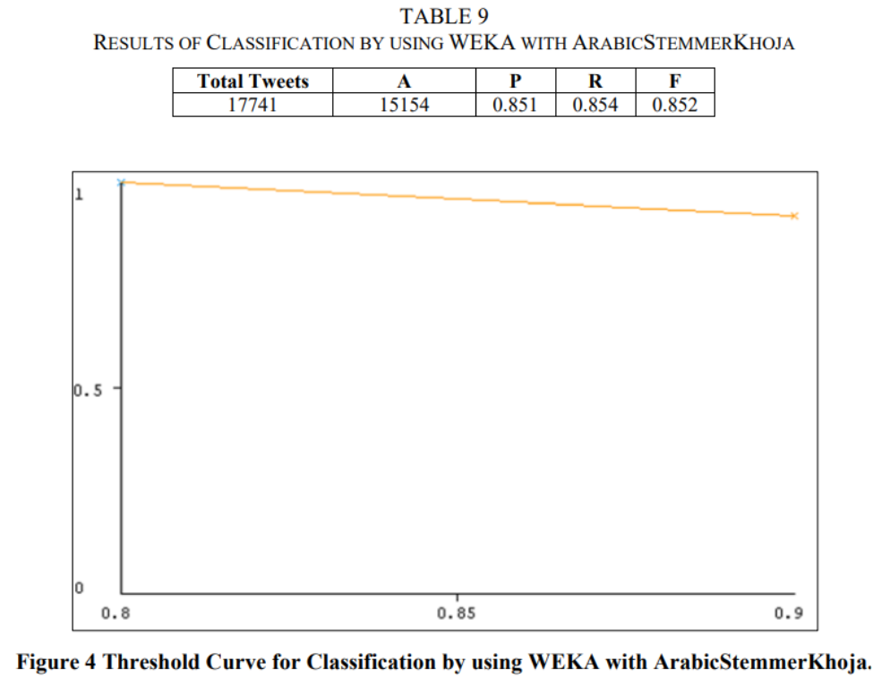
Result of Using WEKA with ArabicStemmer Khoja

Slide 52
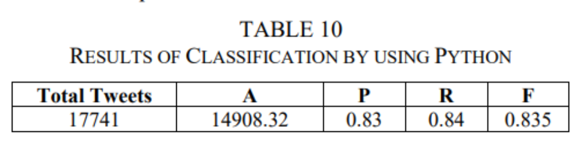
Results of the Experiment performed with the Python supported with the SVM classifier

Slide 53
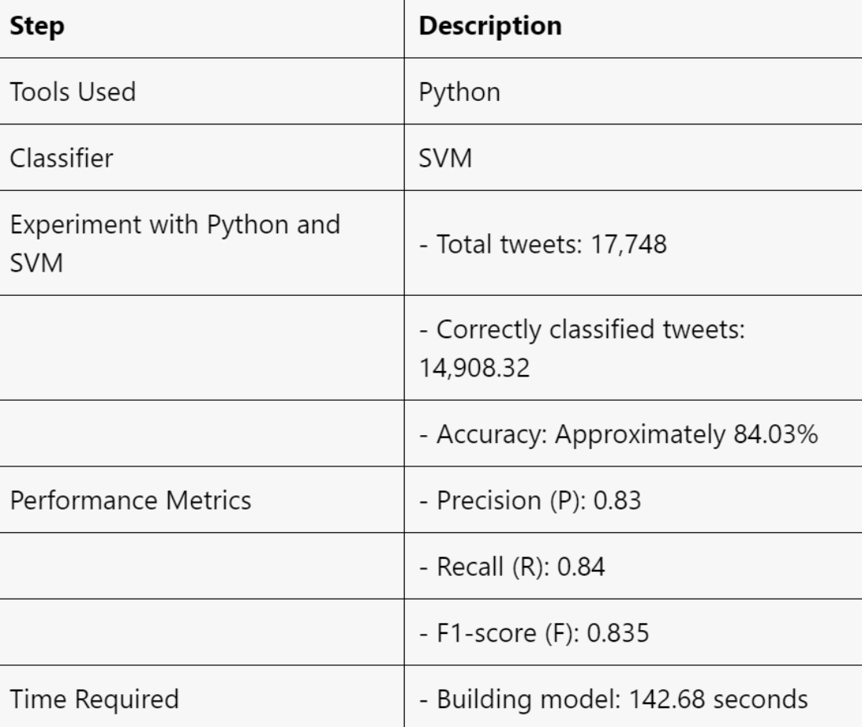

Slide 54

Discussion
Cyberbullying in Arabic tweets was detected using Sentiment Analysis and Machine Learning techniques.
The Arabic language poses challenges like complex morphology and synonyms, making processing difficult.
An annotation method was used to test the approach, with tweets checked by automatic tools and native Arabic speakers.
Data mining tools WEKA and Python, with the Support Vector Machine (SVM) classifier, were applied.
WEKA correctly classified 85.49% of tweets with Light Stemmer and 85.3843% with ArabicStemmerKhoja, while Python achieved 84.03%.
Python performed better than WEKA in terms of model building time, taking 142.68 seconds compared to WEKA's 352.51 seconds.

Slide 55
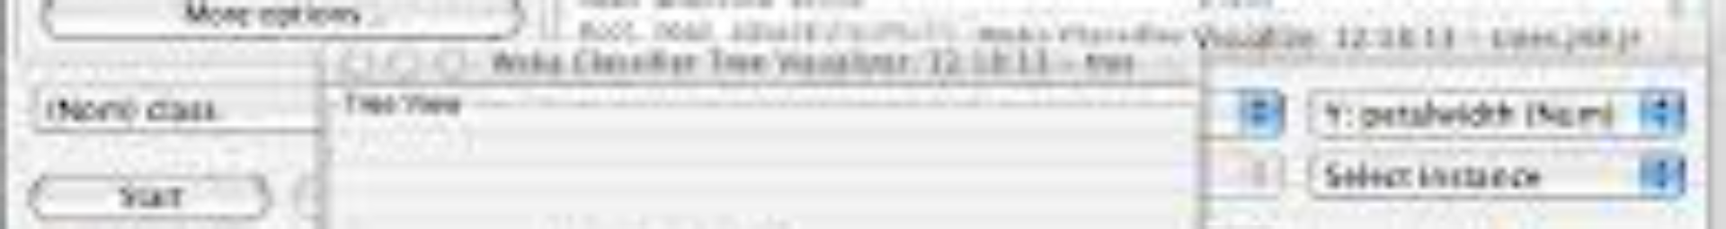

Conclusion
1. Data Collection:
Twitter data collected using AraBully words.
2. Preprocessing:
performed using Microsoft Excel and the Egyptian Journal of Language Engineering. Normalization applied to words. Punctuations, diacritics, and lengthening removed. Tokenization and stop word removal conducted. Data Mining:
WEKA and Python used for data mining. Two stemmers utilized in WEKA.
3. Classification:
SVM classifier employed in both WEKA and Python. WEKA exhibited better performance in tweet classification. Python demonstrated faster model building

Slide 56
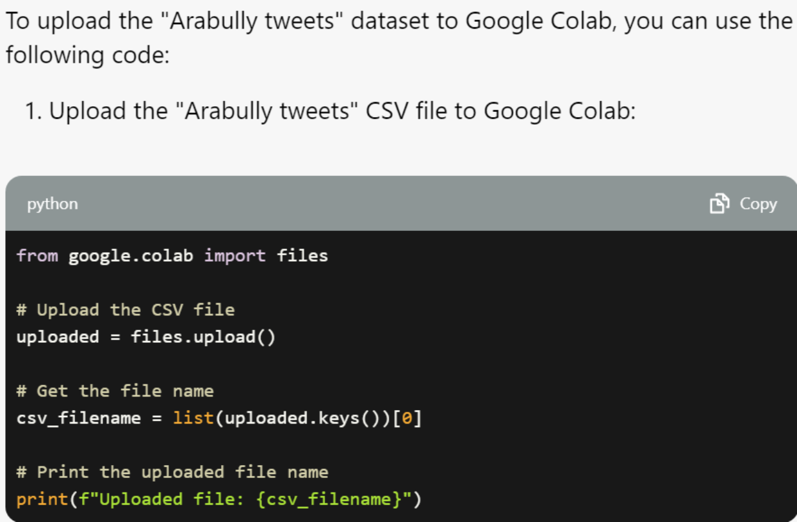

Slide 57
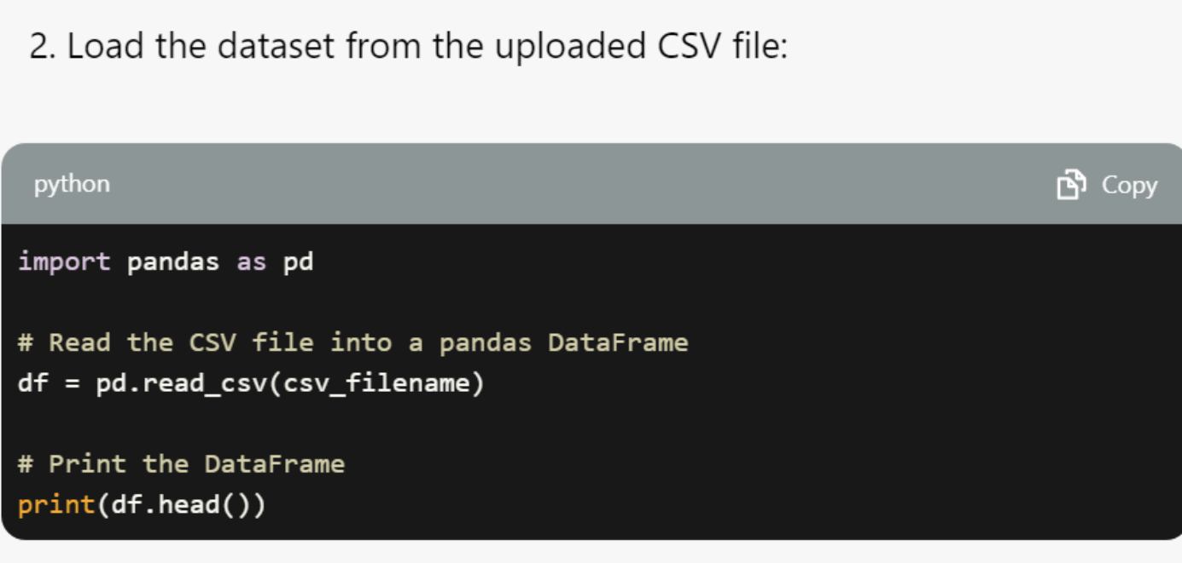

Slide 58


